Slide 1
GREEN STEEL GARDEN
GROUP 11
RYAN AZORE CHRISTOPHER HODGE
JON POWELL JEHRON WILLIAMS
Senior Design II
University of Central Florida
Department of Electrical Engineering and Computer Science

Slide 2
OBJECTIVES & GOALS
Automated Hydroponics System
Capable of Growing 12 Plants
Automatic Nutrient Dispersion & Balancing
Automatic pH Balancing
Mobile App
Wi-Fi Connectivity
Increase Growing Efficiency
Air Stone / Diffuser
Humidity & Temperature detector
Luminosity Detector
Growing Light Cycles
Enclosure Exhaust Fan

Slide 3
SPECIFICATIONS & REQUIREMENTS
PCB with an integrated Wi-Fi and BT module
Runs on 12 to 3.3 VDC.
Microcontroller will operate at a frequency of no less than 16MHz
Control relays to power on and off the lights and pump
Communication of sensor data and pictures via Wi-Fi to data storage in cloud server
Interfaces with a custom iOS app that will display pictures and sensor data
3 liquid storage containers
pH Up
pH Down
Nutrient Solution
Auto-normalize elements in water back to specified levels in less than 1 hour
pH Balance
Nutrient Solution
Exhaust fan
Restore temperature and humidity levels in less than 30 minutes.

Slide 4
SPECIFICATIONS & REQUIREMENTS
The total cost of the build shall not exceed $1300
Power Supply will receive 120 V 60 Hz AC power and covert to 12 V DC
Growing System will be completely enclosed
The system will be able to grow 12 plants at one time
The system will have LED lighting
Placed no less than 24” above plants
Feature | Desired Value
Dimensions | 24”x36”x72”
Number of Plants | 12
Water Capacity (Reservoir) | 5 Gallons
pH Balance adjust time | < 60 mins
EC Level adjust time | < 60 mins
PCB Operating Voltage | 12 Volts
Operating Environment | Indoors
Sensor Readout Time | < 60 seconds
Project Requirement Table

Slide 5
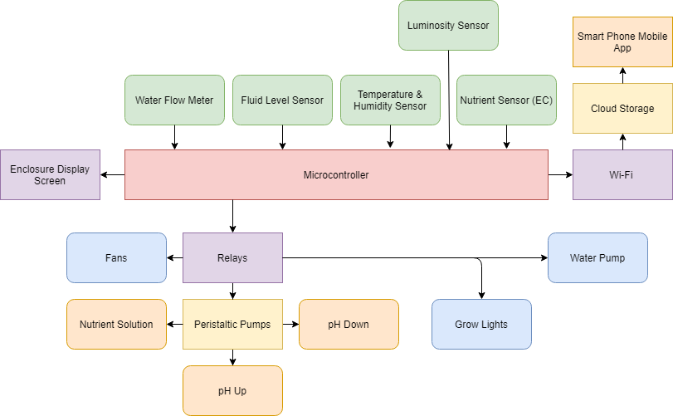
SYSTEM DIAGRAM

Slide 6
DESIGN DECISIONS – HYDROPONIC SYSTEM
Nutrient Film Technique
Reservoir tank holding nutrient solution
Aerator oxygenates tank water
Sloped Grow Tray
Water + Nutrient Solution is fed down through the slope, with excess liquid returning to the reservoir tank
Compatible with automation features
Constant Feedback system
Cheap to construct
Nutrient Film Technique

Slide 7
DESIGN DECISIONS – PLANT CHOSEN
Arugula Leaves
Arugula
Works with any Hydroponic Method
pH Range
6 – 7.5
EC Range
.8 – 1.2
Necessary Hours of Light per Day
12+
Days for Germination
7 - 10

Slide 8
DESIGN DECISIONS – GROWTH ENCLOSURE
Frame constructed of steel
Provides better strength and durability compared to other competitors
Offers fixed structure instead of a tent-like build
Wheels are attached for easy indoor and outdoor mobility
Frame Construction

Slide 9
COMPONENT DECISIONS – MICROPROCESSOR
Arduino Mega 2560
Open source
Makes PCB design easier
54 digital I/O pins
Standard Arduino
Has enough connections for all the sensors used in the design
Arduino MEGA 2560

Slide 10
COMPONENT DECISIONS – EC SENSOR
Grove Electrical Conductivity Sensor
Atlas Scientific Conductivity Probe

Slide 11
COMPONENT DECISIONS – PH SENSOR
PH0-14 pH Sensor
Atlas Scientific pH Probe

Slide 12
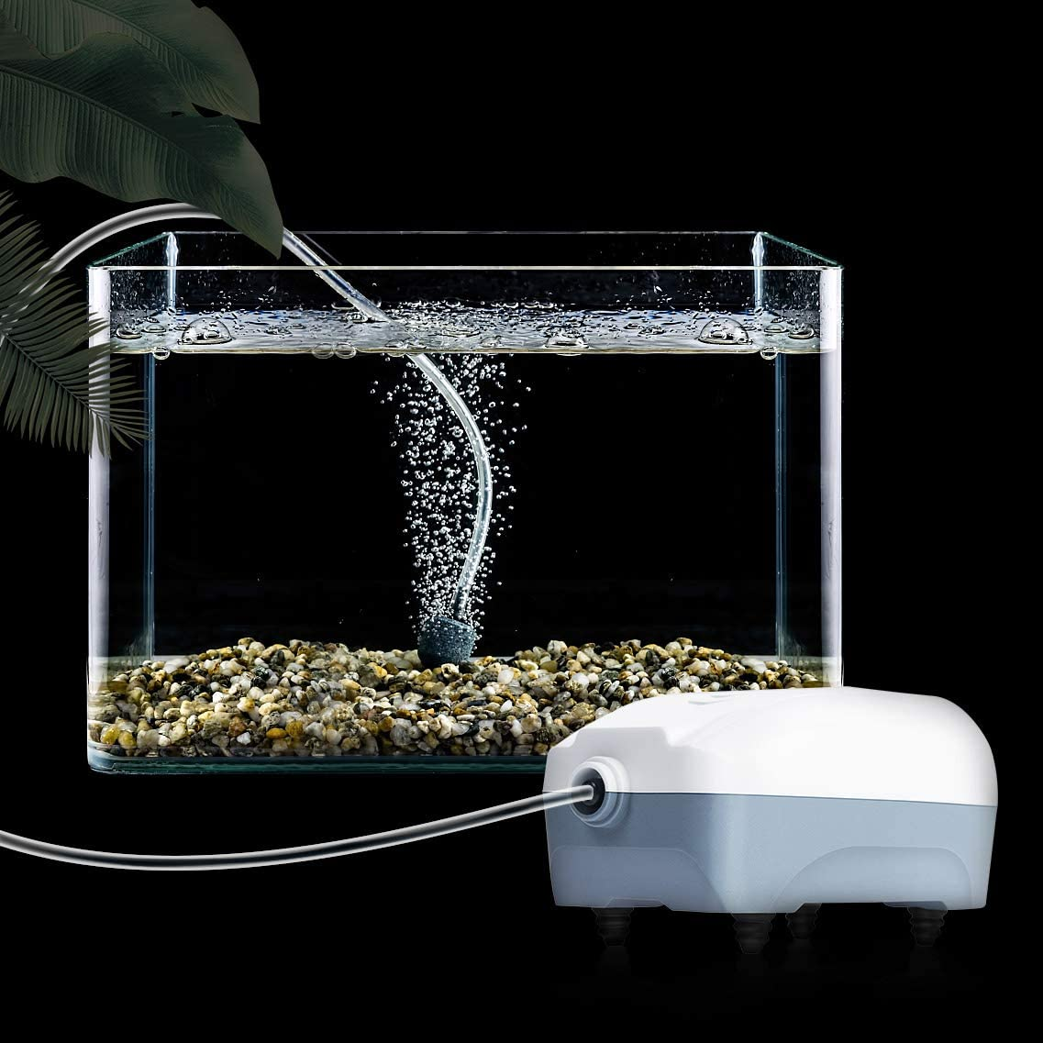
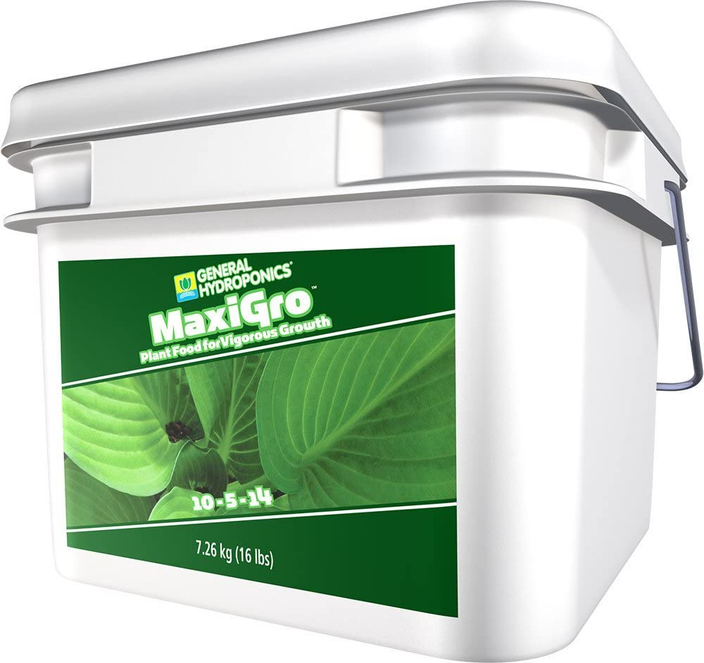
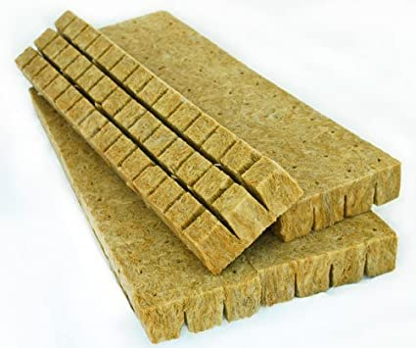
COMPONENT DECISIONS – MISCELLANEOUS
Air stone
This is not a required component for the system to function, but it improves the efficiency of the growing process
Nutrients Solution
Dry vs. Liquid
Plant Determined
Growing Medium
Rockwool
MaxiGro Dry Plant Food
Air Stone Demonstration
Rockwool Medium

Slide 13
DESIGN CONSTRAINTS
Economic
Many parts proved to be more expensive than initially overviewed
Environmental
Temperature fluctuations are difficult to control outdoors, necessitating indoor use
Size
The enclosure must be suitable for indoor use and must be adequately proportioned
Health & Safety
pH buffers and nutrient solution can cause irritation due to potency
Potential build up of foreign agents in system after regular use
Time
Design must be functional and constructed by a certain deadline

Slide 14
DESIGN STANDARDS
IEE 802.11 Standard
Wi-Fi compatibility with modern networks
Serial Peripheral Interface (SPI)
Interface supported by microcontroller
Inter-Integrated Circuit (I2C)
Interface supported by microcontroller
Programming Language
C Standard
ISO/IEC/IEEE 29119
Standards for software testing

Slide 15
BUDGET & FINANCE
Part | Quantity | Price
Peristaltic Pump | 3 | $9 .50
Silicone Tubing | 1 | $9.99
Wi-Fi Module (4) | 1 | $11.99
5” Caster Wheels | 1 | $29.99
Main Water Pump | 1 | $11.99
Main Water Reservoir | 1 | $16.47
Solutions Container (6) | 1 | $11.99
Arduino MEGA 2560 | 1 | $19.90
Wi-Fi Breadboard Adapters (5) | 1 | $9.99
Water Filter | 1 | $8.99
Water Level Gauge | 1 | $28.99
Steel Structure | 1 | $280.68
LED Lights | 1 | $39.99
Air Pump | 1 | $9.99
pH Solution | 1 | $20.05
Plant Nutrients | 1 | $15.99
EC Probe | 1 | $113.99
pH Probe | 1 | $55.99
Luminosity Sensor | 1 | $10.98
Power Supply | 1 | $12.77
Flow Meter | 1 | $9.49
Temperature & Humidity Sensor | 1 | $19.84
Grand Total | 24 Parts | $759.55

Slide 16
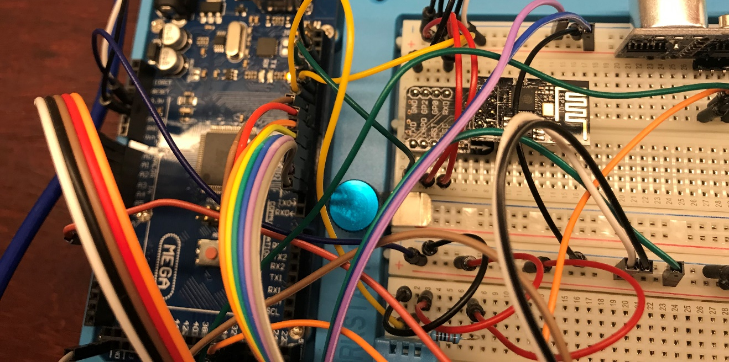
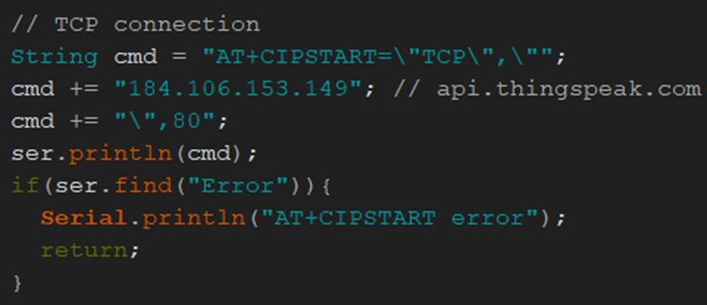
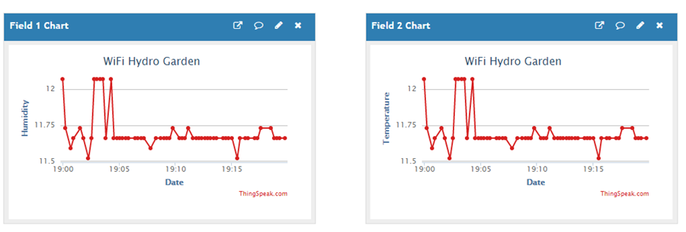
NOTABLE SUCCESSES
ESP8266 Wi-Fi Breadboard Layout
Wi-Fi Connectivity
Setting up Wi-Fi Module
Defined protocol, address, and port
AT + CIPSTART
Thingspeak.com

Slide 17
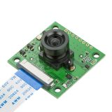
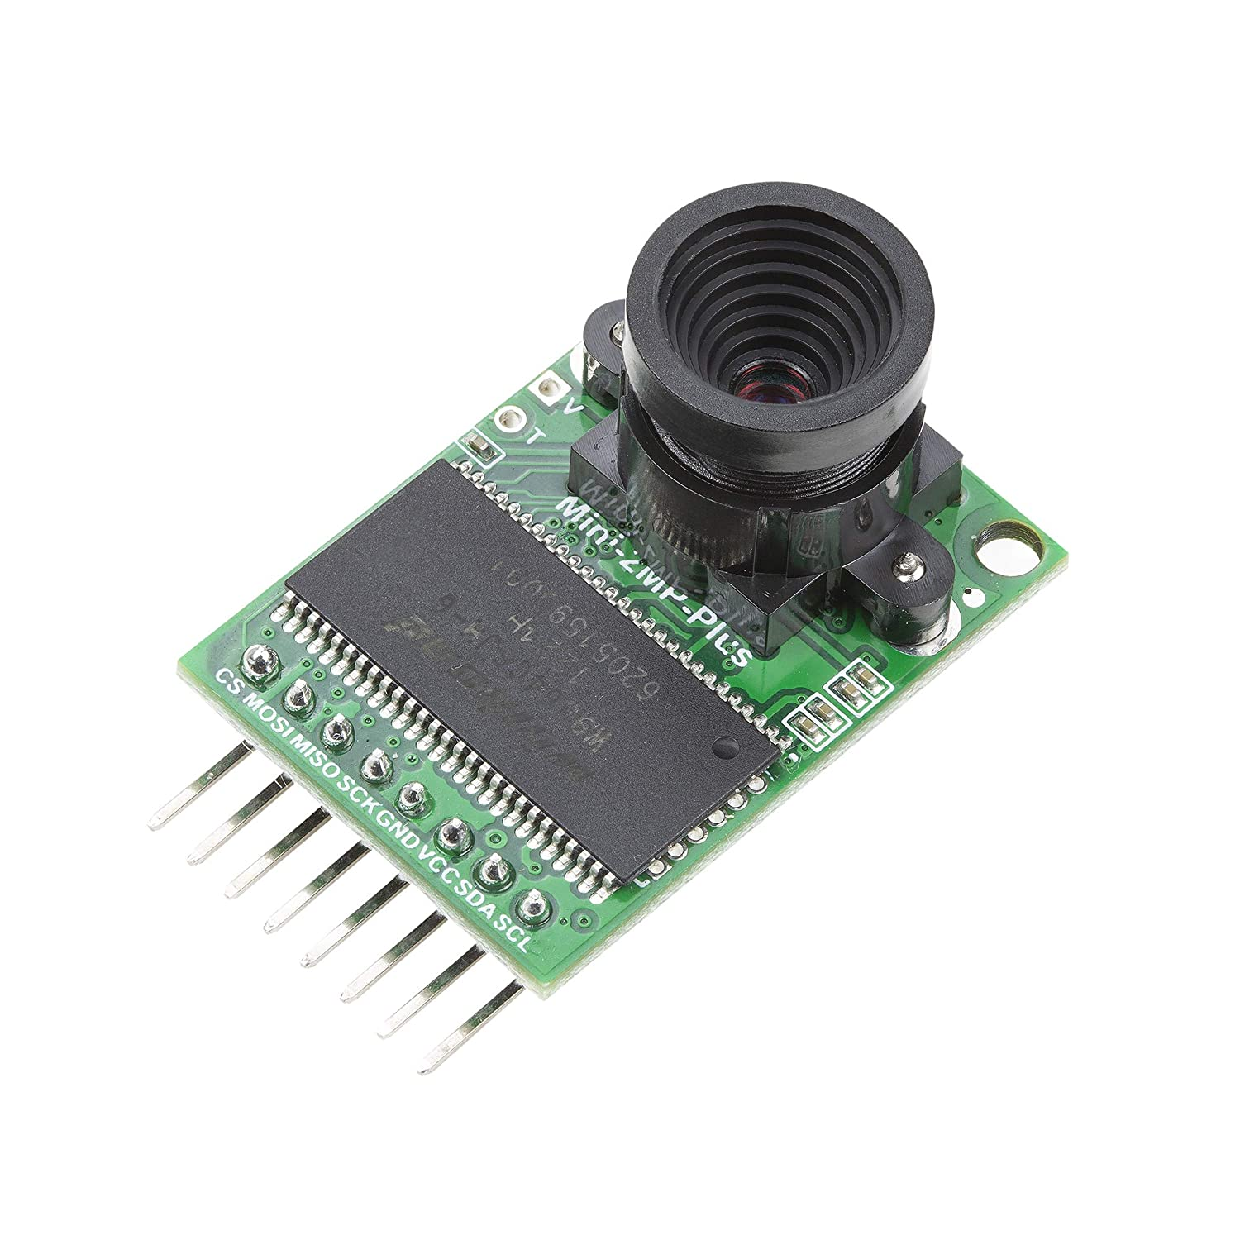
DIFFICULTIES ENCOUNTERED
Camera Compatibility
Arduino’s do not possess enough storage and processing capabilities for high resolution camera capability
Arducam 8 (IMX219)
Despite the name being Arducam, the sensor equipped is only compatible with Raspberry Pi’s
Arducam Mini (OV2640)
This Camera module is 2 Megapixels only and does not offer the quality expected by early design requirements

Slide 18
CURRENT PROGRESS

Slide 19
FUTURE GOALS
Development Plans | 7-Oct | 15-Oct | 21-Oct | 30-Oct | 7-Nov | 14-Nov | 21-Nov | 30-Nov
PCB Development
Enclosure Construction
Mobile App Development
PCB Assembly & Testing
Sensor & PCB Integration
Final Assembly
Growing Tests
Table of Development Plans

